Slide 1


Introductory lecture
Lecture #0

Slide 2
CAP615 PROGRAMMING IN JAVA
The Kick Start Session

Slide 3
Course details
LTP – 3 0 0 [Three Lecture/week]
Text Book
JAVA: THE COMPLETE REFERENCE by HERBERT SCHILDT, MCGRAW HILL EDUCATION

Slide 4
References:
INTRO TO JAVA PROGRAMMING (COMPREHENSIVE VERSION) by Y. DANIEL LIANG, Pearson Education India
PROGRAMMING WITH JAVA by E BALAGURUSAMY, Tata McGraw Hill, India

Slide 5
Course Assessment Model
Marks break up
Attendance 5
CA (2 best out of 3) 25
MTT 20
ETT 50
Total 100

Slide 6

The hitch…
Three BURNING questions in mind…
Why we are learning Java?
What would we do with it?
What will the course outcome?

Slide 7
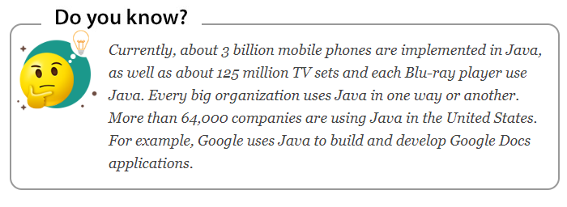

Slide 8
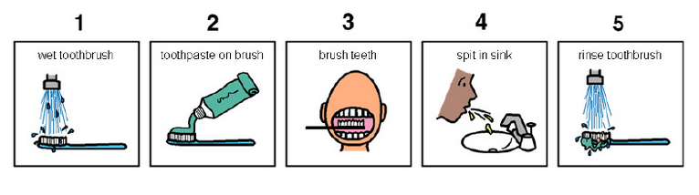
Daily routine
Let us look around our daily routine…
Let us see where all we do programming everyday
Simple things we do to start the day
So there is ONE program you know which is there in you…

Slide 9

Daily routine
Start
There is a set procedure
Each step is defined
The occurrence is ordered
Jump is NOT permitted
A step cannot be skipped
Pick Brush
Rinse Brush
Apply Paste
Brush
Rinse Mouth
Rinse Brush
Stop

Slide 10




So what does this mean?
Take ANY activity of the day…
It will have a set procedure
It has to be done in a designate way
If not done the specified way will yield wrong results
This clearly shows that everything has a
Logic

Slide 11
What next?
If there is logic in anything then . . .
There has to be ways to represent logic
There has to be modes to modify and re-represent logic
There should be methodology to implement and re-design logic
And for all this…

Slide 12


What next?
There has to be logic machine to assimilate, understand, solve, store, retrieve and represent logic
There has to be a LANGUAGE to communicate with the logic machine
Otherwise….

Slide 13





Diving deeper…
How do I become the master of JAVA?
By working more harder and executing various logics correctly

Slide 14
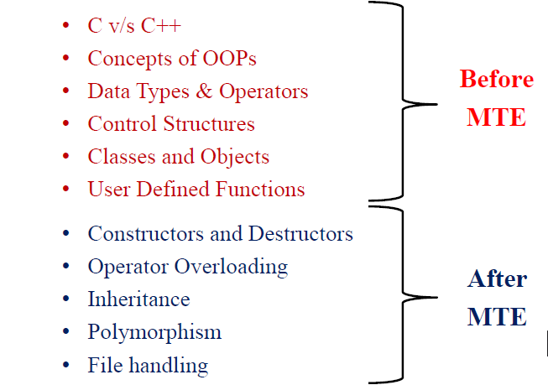
Course Content
Basic java concepts
Classes
Arrays & strings
Inheritance
Collection framework
Multithreading
Swings
Layouts
JDBC
CRUD operations
Network Programming

Slide 15
UNIT-1

Slide 16
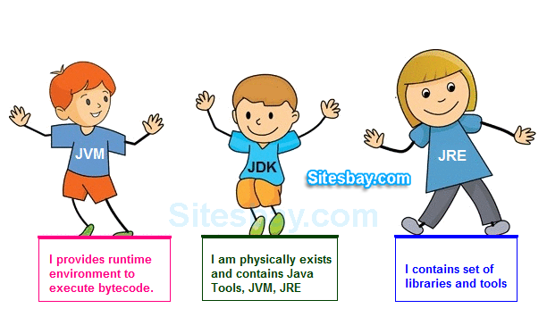
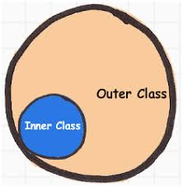
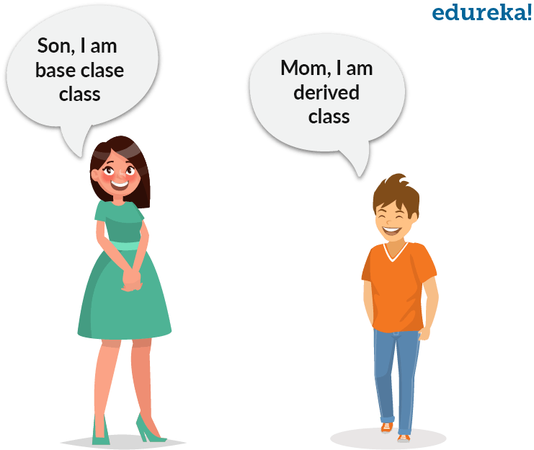
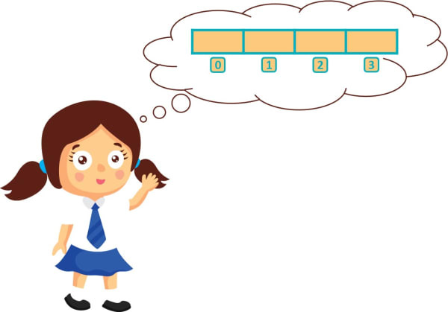
What do we need to know?

Slide 17
UNIT-2

Slide 18
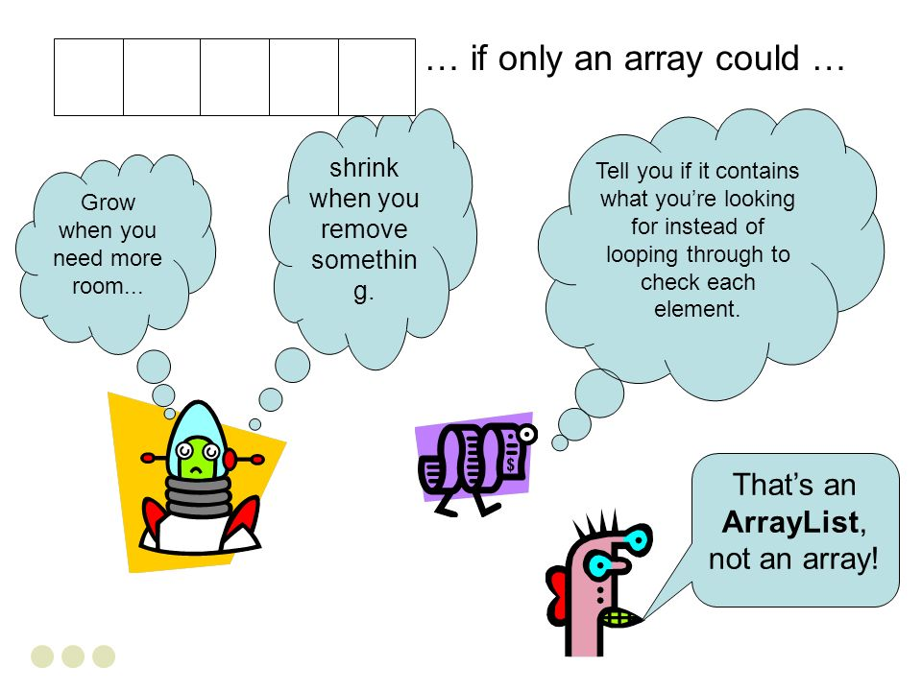
What do we need to know?

Slide 19
UNIT-3

Slide 20
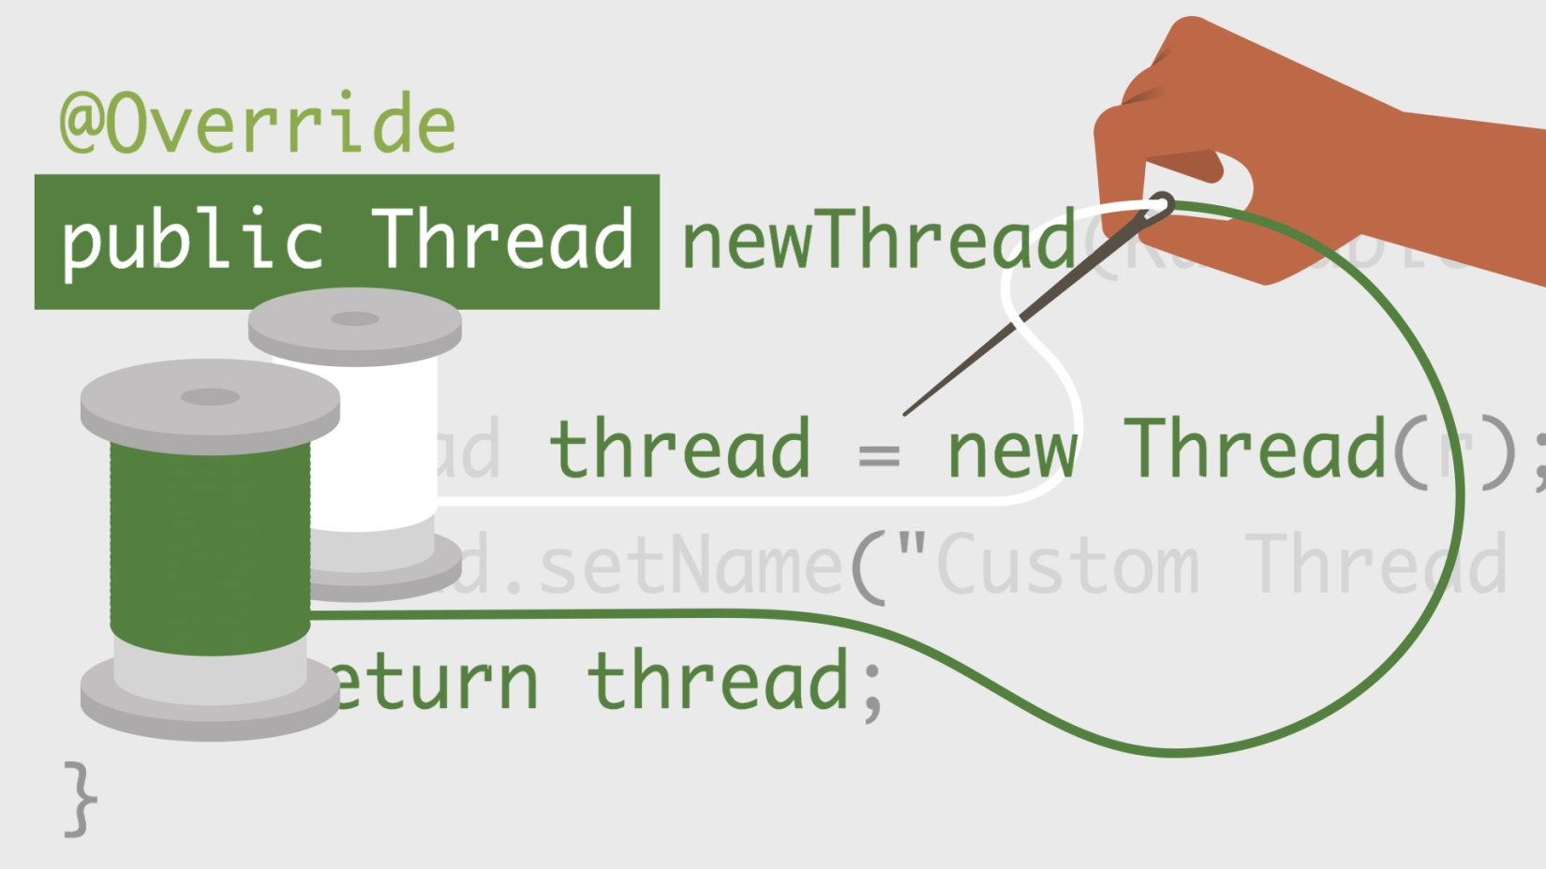
What do we need to know?

Slide 21
UNIT-4

Slide 22
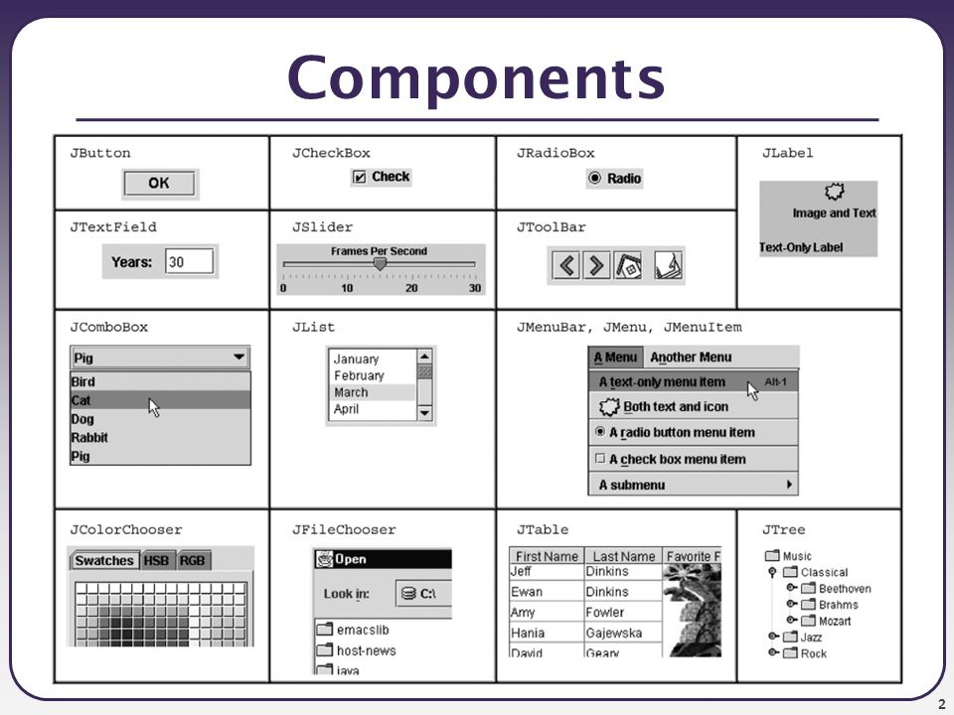
What do we need to know?

Slide 23
UNIT-5

Slide 24
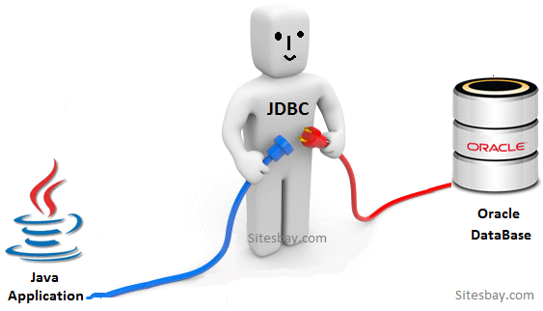
What do we need to know?

Slide 25
UNIT-6

Slide 26
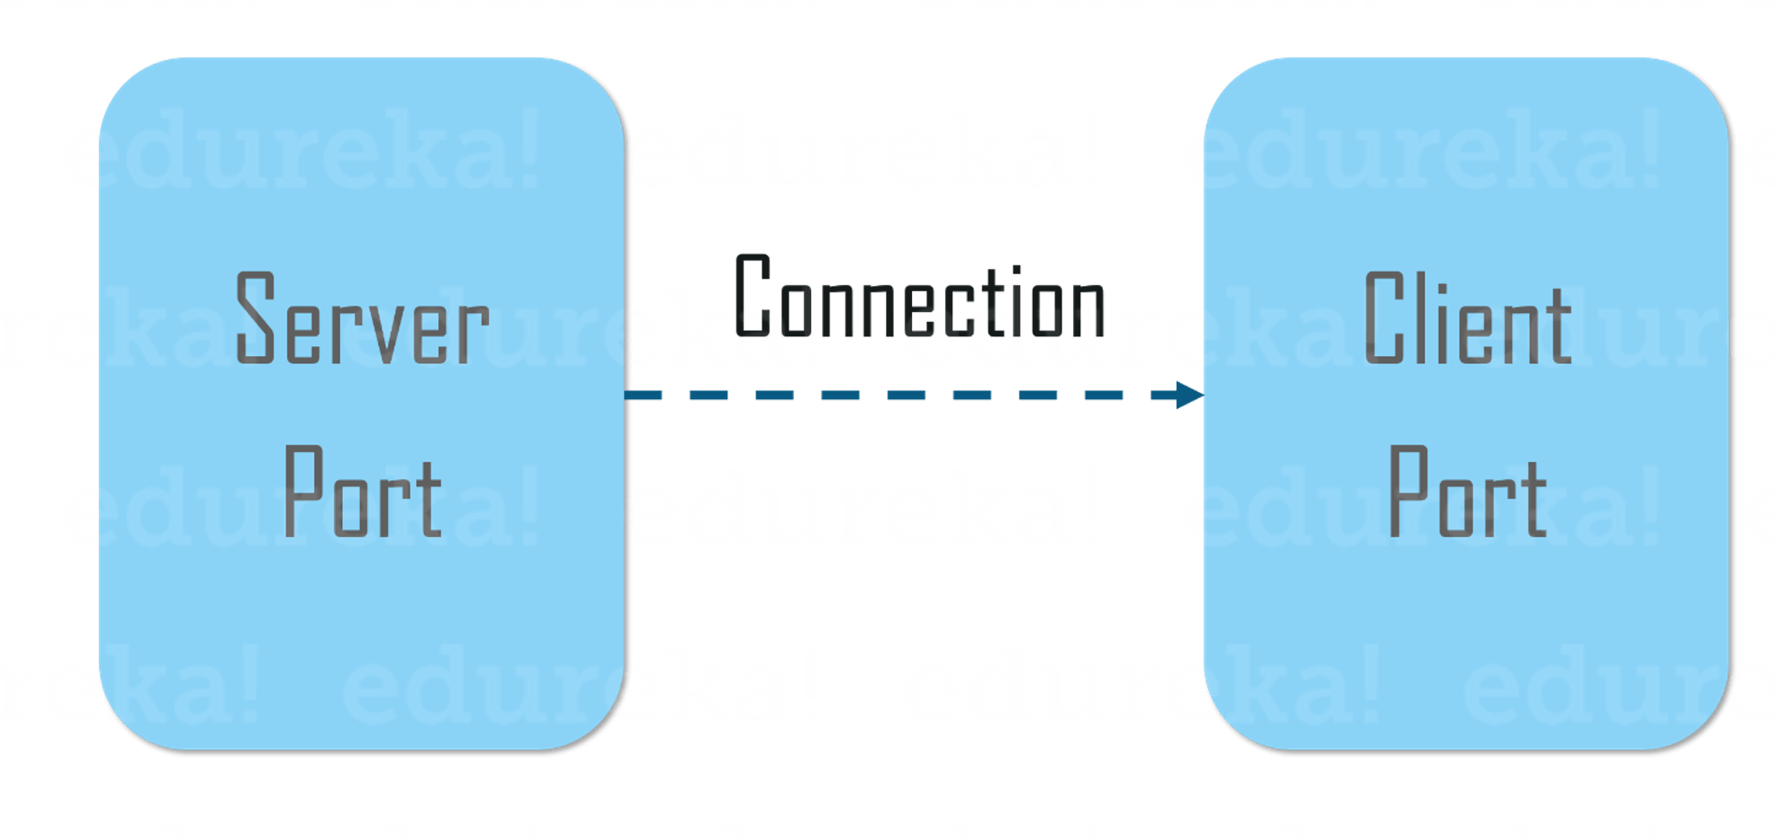
What do we need to know?

Slide 27
The course outcome…
CO1 :: define the structure and model of the Java programming language
CO2 :: understand the accessibility of fields and methods of an object through String and StringBuilder classes
CO3 :: analyze object serialization with file handling and exception handling to overcome runtime errors
CO4 :: evaluate user requirements for software functionality and assess its implementation in java
CO5 :: develop applications in Java programming language to solve problems

Slide 28
We can develop applications using Java Like….

Slide 29
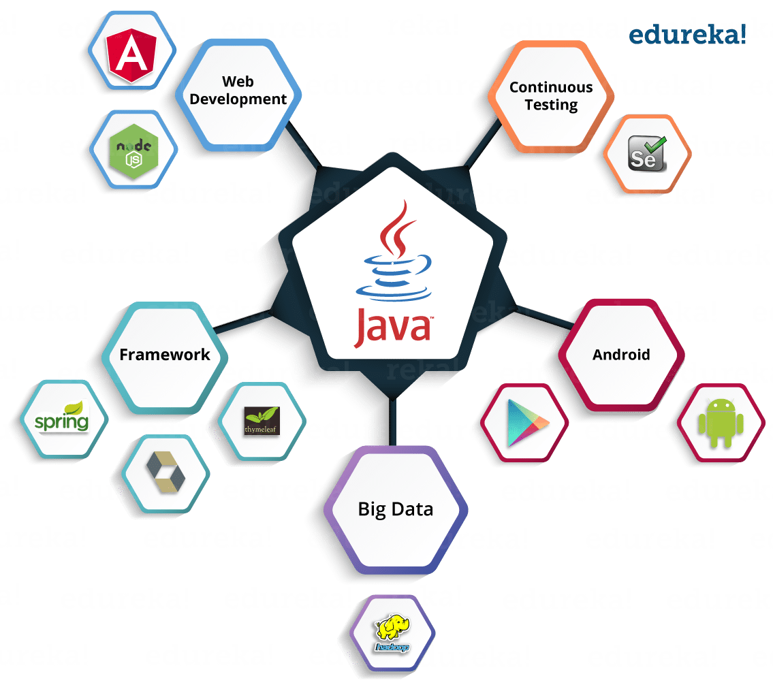

Slide 30
Next Class: Introduction to Java

Slide 31
Thank You

